Slide 1
Internet of Things and its applications
Pasquale Puzio Sistemi e Reti Wireless
a.a. 2010/2011
Università di Bologna

Slide 2
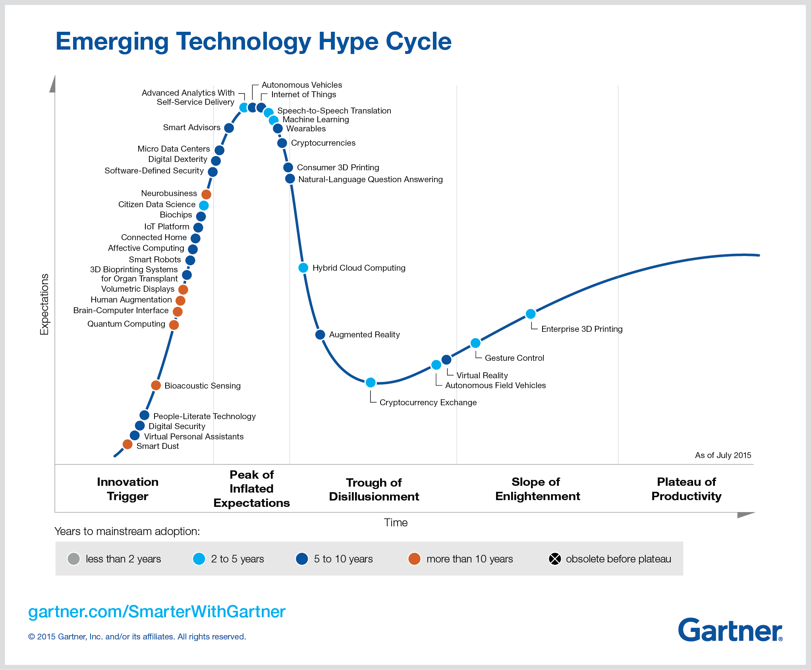

Slide 3
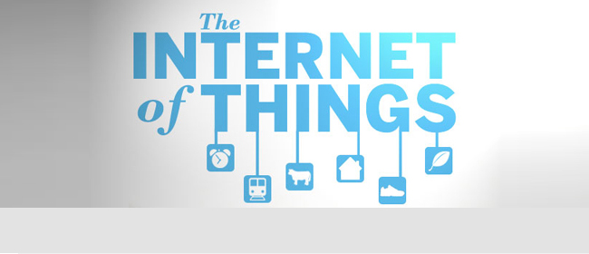
What's Internet of Things

Slide 4
Definition
CERP-IOT: Internet of Things (IoT) is an integrated part of Future Internet and could be defined as a dynamic global network infrastructure with self configuring capabilities based on standard and interoperable communication protocols where physical and virtual ‘things’ have identities, physical attributes, and virtual personalities and use intelligent interfaces, and are seamlessly integrated into the information network. In the IoT, ‘things’ are expected to become active participants in business, information and social processes where they are enabled to interact and communicate among themselves and with the environment by exchanging data and information ‘sensed’ about the environment, while reacting autonomously to the ‘real/physical world’ events and influencing it by running processes that trigger actions and create services with or without direct human intervention. Interfaces in the form of services facilitate interactions with these ‘smart things’ over the Internet, query and change their state and any information associated with them, taking into account security and privacy issues.

Slide 5
The Internet of Things
“Internet of Objects”
“Machine-to-Machine Era”
“Internet of Everything”
(1) The Internet of Things, also called The Internet of
Objects, refers to a wireless network between objects,
usually the network will be wireless and self-configuring, such as household appliances.
------Wikipedia
(2) Internet of Things refers to the concept that the
Internet is no longer just a global network for people to
communicate with one another using computers, but it is
also a platform for devices to communicate electronically
with the world around them.”
--Center for Data and Innovation

Slide 6
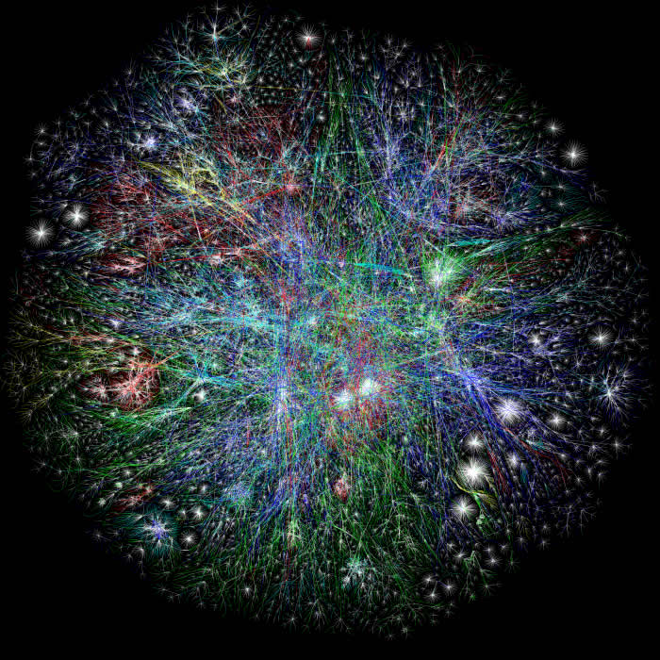
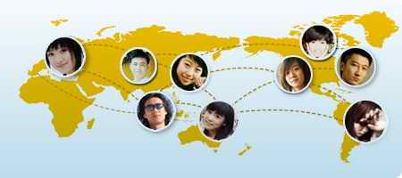
Starting from the Internet
Internet appears everywhere in the world
but it is still a connection between people and people

Slide 7
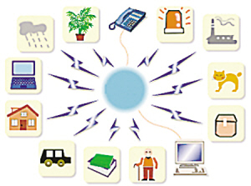
What is the Internet of Things?
Internet connects all people, so it is called “the Internet of People”
IoT connects all things, so it is called “the Internet of Things”

Slide 8
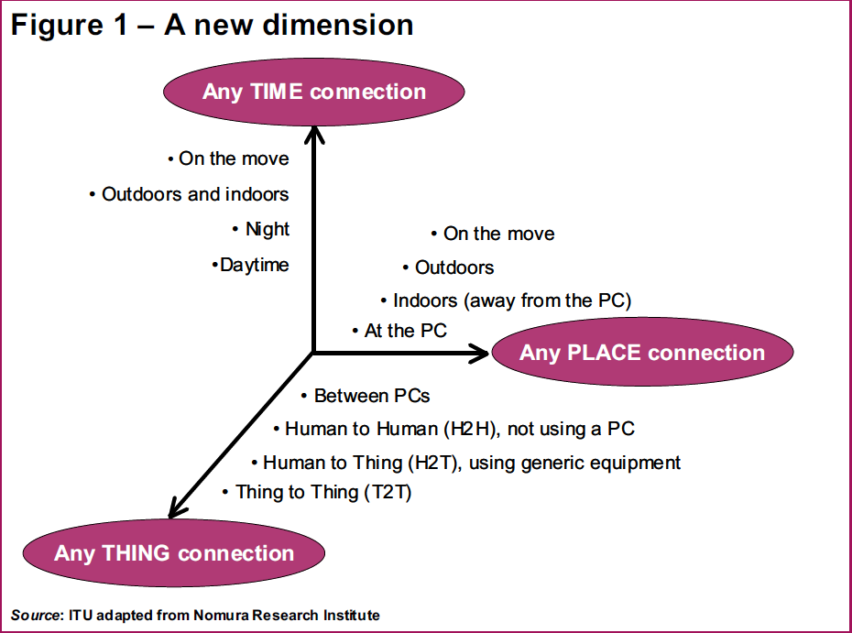
Welcome to our NEW DIMENSION

Slide 9
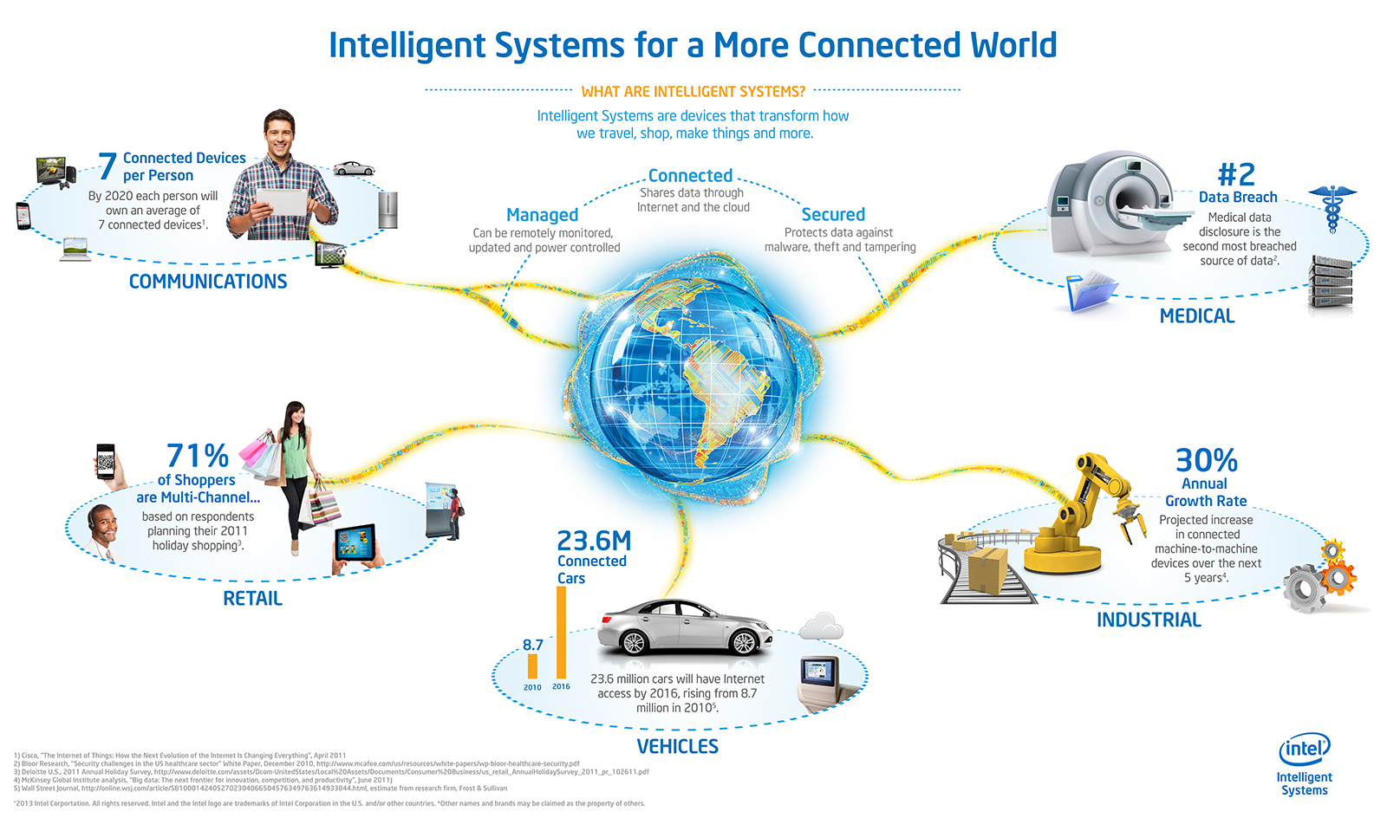
Opportunities

Slide 10
The Applications of Iot
Regional Office
Biosensor taken by people
House
Network
Equipment in public place
Transportation Vehicle
Virtual Environment

Slide 11





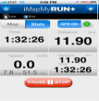
People Connecting to Things
ECG sensor
Internet
Motion sensor
Motion sensor
Motion sensor

Slide 12
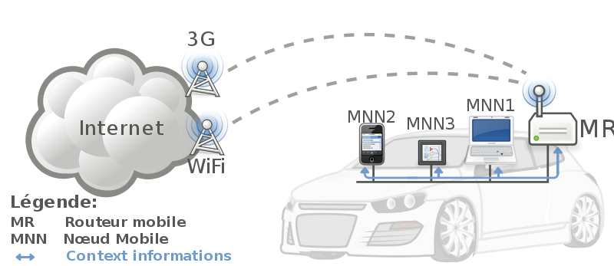
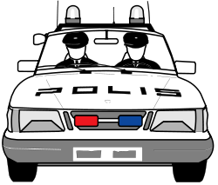

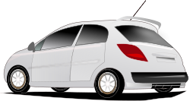
Things Connecting to Things
- Complex and heterogeneous
resources and networks

Slide 13







Wireless Sensor Networks (WSN)
End-user
Gateway
Core network
e.g. Internet
Sink
node
Gateway
Computer services
The networks typically run Low Power Devices
Consist of one or more sensors, could be different type of sensors (or actuators)

Slide 14
CISCO'S PREVISION
In 2008 the number of things connected to the Internet was greater than the people living on Earth.
Within 2020 the number of things connected to the Internet will be about 50 billion.

Slide 15
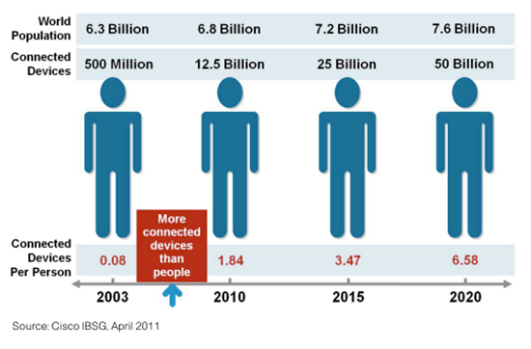

Slide 16
Features
Univocally identifiable and addressable objects
Artificial Intelligence
Architecture
Geo-Localization
Size Considerations

Slide 17
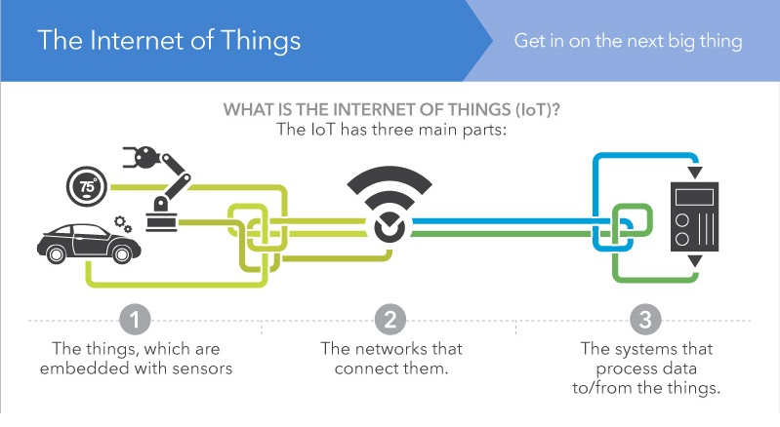

Slide 18
Technologies
RFID
WiFi IEEE 802.11
Barcode e QR Code
ZigBee IEEE 802.15.4
Sensors and smartphones

Slide 19
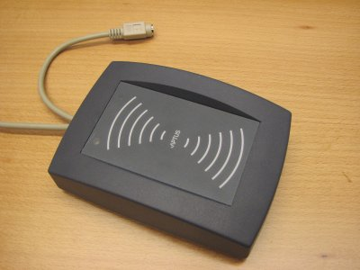
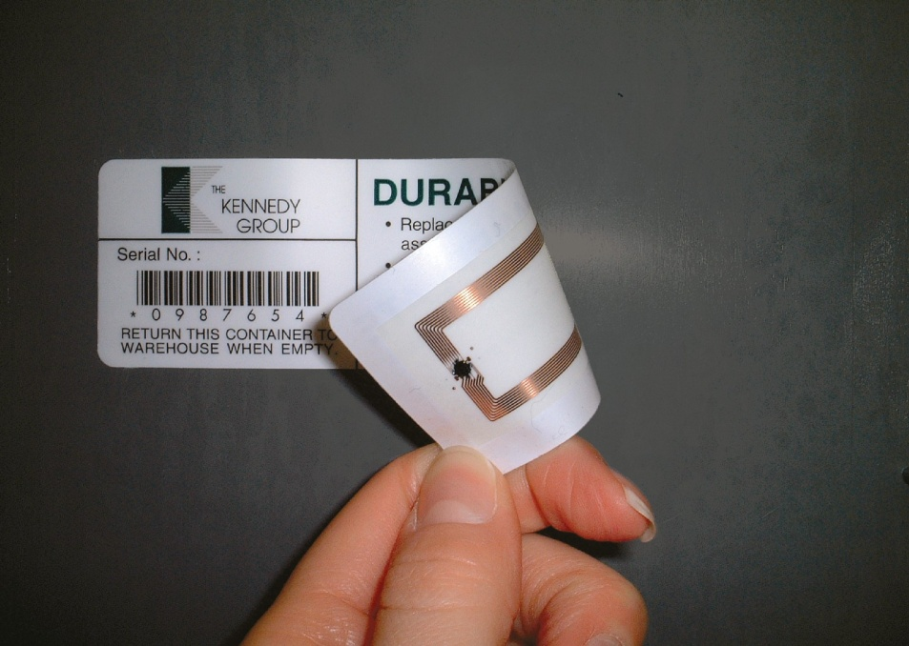
RFID

Slide 20
RFID
Widely used in Transport and Logistics
Easy to deploy: RFID tags and RFID readers
The communication range and the frequency depends on the type of technology

Slide 21
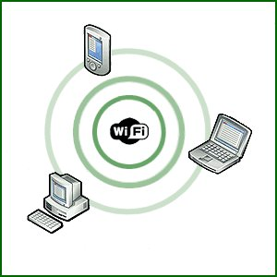
WiFi

Slide 22
WiFi
Very common
Widely used both in indoor and outdoor environments
General purpose
Low cost
Highly interoperable
Maybe not a good solution in some special conditions

Slide 23
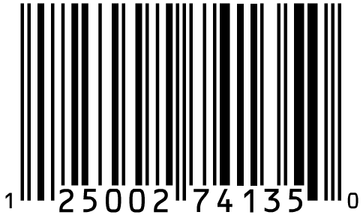
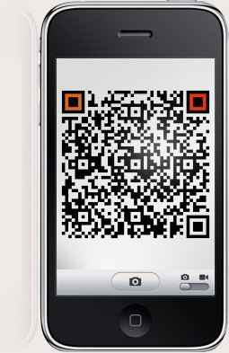

Barcode & QR Code

Slide 24
Barcode e QR Code
Low cost
No technological difficulties
Several devices can read a barcode
Starting point for more complex systems
Example: price comparison

Slide 25
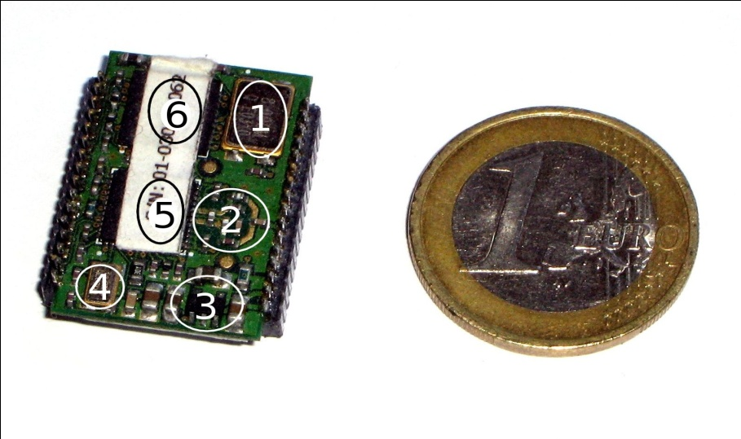
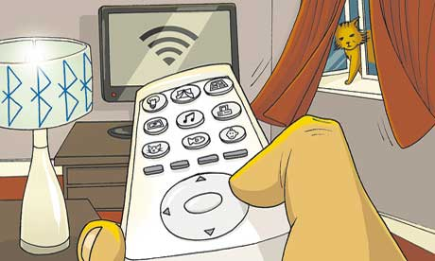
ZigBee

Slide 26
ZigBee
Low cost
Very long battery life
Easy to deploy
Large number of nodes (up to 64770)
Can be used globally
Secure
Ideal for WPAN and mesh networks
Support for multiple network topologies

Slide 27
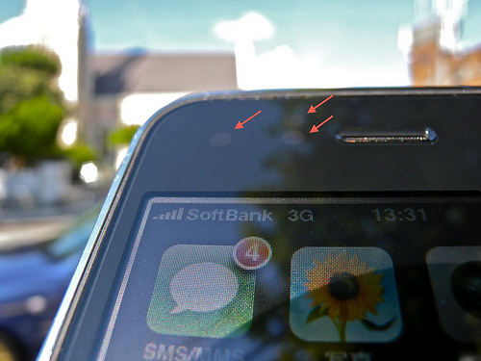
Sensors and smartphones

Slide 28
Sensors and smartphones
In the near future almost everybody will probably have a smartphone
A smartphone isn't just a mobile phone that has access to the Internet
The iPhone has a lot of different types of sensors

Slide 29
Top Applications
Traffic monitoring
Health
Security
Transport and Logistics
Daily life and domotics
Notes:
Domotics – Control of domestic appliances by ECS

Slide 30
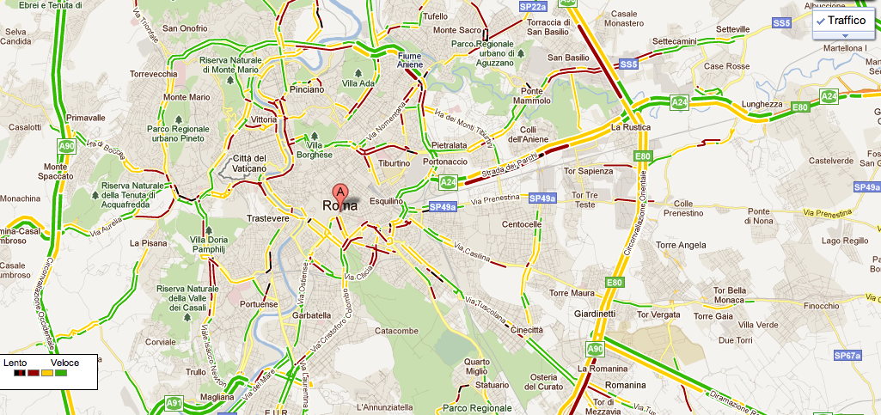
Google Traffic

Slide 31
Google Traffic
Not exactly an IoT application
Example of an application for everyday usage.

Slide 32
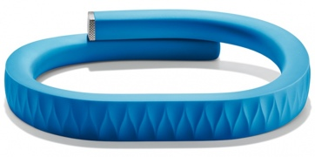
Jawbone UP

Slide 33
Jawbone UP
Linked to an iPhone application
Not just a passive bracelet
The application recommends to change life-style or diet

Slide 34
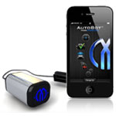
AutoBot

Slide 35
AutoBot
Diagnostics service for cars
Alerts relatives in case of an accident
Discovery service of car position
Integrated with several web services

Slide 36
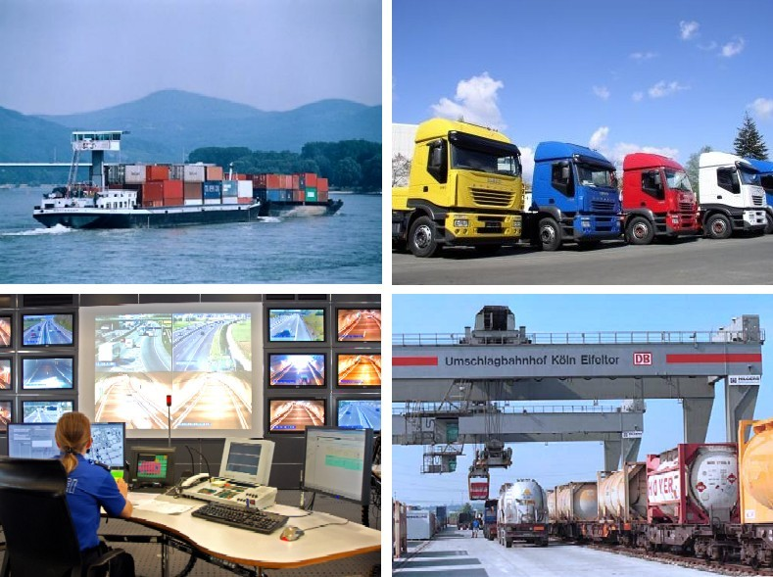
Transport and Logistics

Slide 37
Transport and Logistics
One of the first business sectors interested in IoT technologies
Currently two systems are already available and deployed: ConLock and ContainerSafe
Integration of light sensors, GPS and GSM

Slide 38
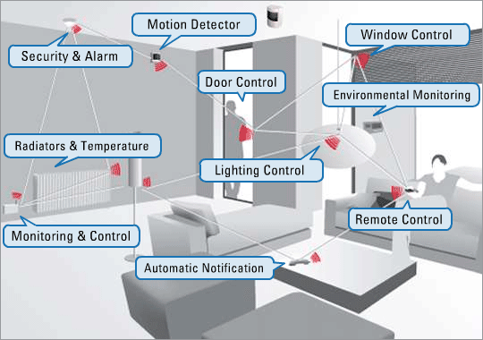
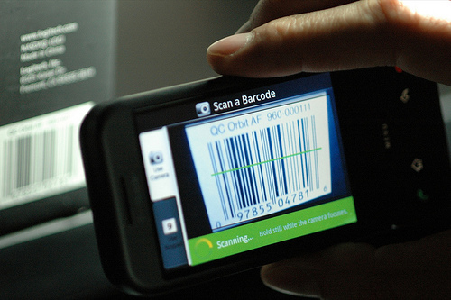
Daily Life and Domotics

Slide 39
Daily Life and Domotics
Many possible developments to Domotics
There are no standard and widely accepted solutions yet for Domotics
A framework has been developed for Home Automation applications: FreeDom

Slide 40
Web of Things
To achieve IoT we need a universal protocol to combine several heterogeneous devices.
This protocol should be: simple, lightweight, loosely-coupled, scalable, flexible and standard.
Sounds like the WEB

Slide 41
Web of Things
Several technologies and protocols already available and widely accepted by the community:
HTTP, TCP, IPV6, XML, JSON, RSS, ATOM, REST, WS-*, URI, etc.
URI to make the objects easily identifiable and addressable
XML, WS-* and REST to allow the objects to expose their features and to communicate with external or centralized services
Simpler mashup

Slide 42
Issues
Privacy
Security

Slide 43
The future of IoT
World sensor networks
Home automation and domotics
Daily life (traffic monitoring, shopping, etc.)
Tracking and shipping of goods
Health
Unpredictable developments...

Slide 44
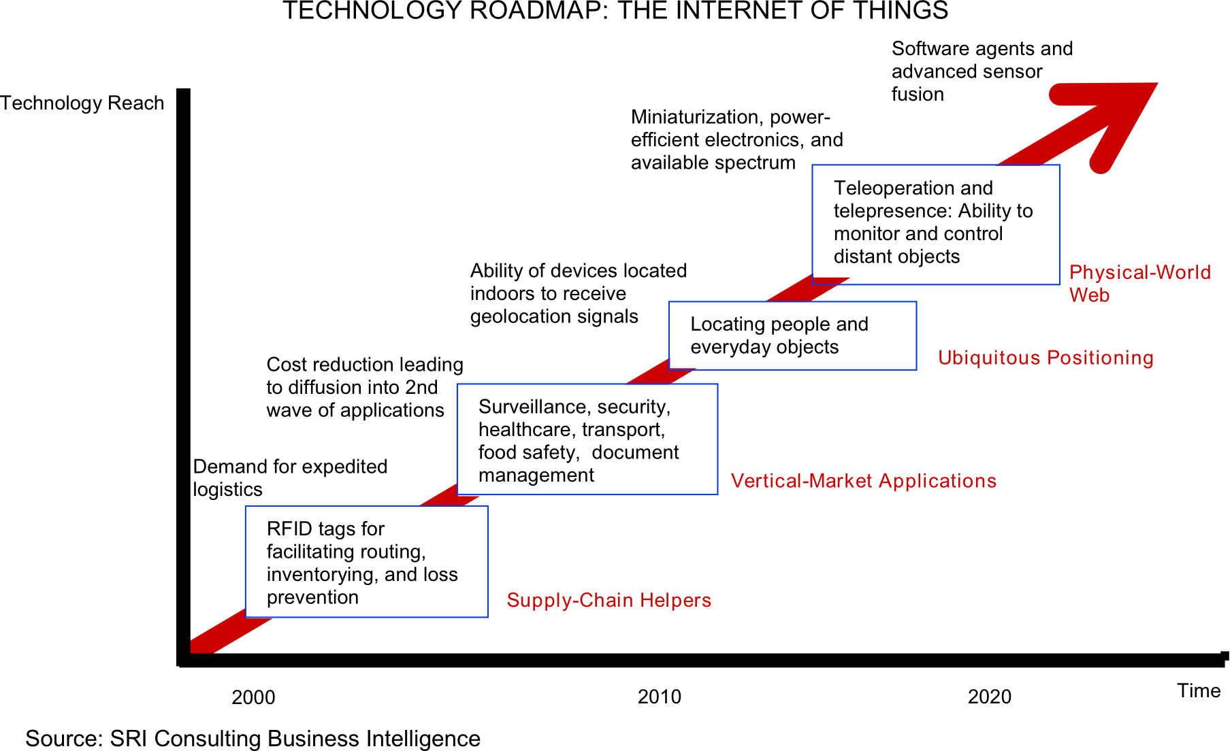
IoT roadmap

Slide 45
References
Kevin Ashton: That 'Internet of Things' Thing. In: RFID Journal, 22. Juli 2009. Abgerufen am 8. April 2011
Cisco: Over 50 billions of devices connected to Internet http://blogs.cisco.com/news/the-internet-of-things-infographic/
Vlad Trifa: HomeWeb and Android at Home – challenges? http://www.webofthings.com/2011/06/10/homeweb-and-android-at-home-challenges/
IoT - Visit the future: http://www.iot-visitthefuture.eu/index.php?id=108

Slide 46
References
Google Favorite Places: http://www.google.com/help/maps/favoriteplaces/business/barcode.html
Jawbone UP: http://jawbone.com/up/preview
AutoBot: http://mavizontech.com/MeetMavia.htm
IoT for Shipping: http://www.iot-visitthefuture.eu/?id=113
Social Web of Things: http://www.ericsson.com/thinkingahead/idea/110217_social_network_for_you_1968920151_c

Slide 47
References
FreeDom - Open Source Home Automation: http://freedom.disi.unitn.it/
ZigBee Alliance: http://www.zigbee.org/
Web of Things: http://www.webofthings.com/

Slide 48


